Slide 1
Final Project: House CREATOR
Megan, Alan, Yves, Reese

Slide 2
How it works AND WHAT IT DOES
-Builds a house scene
-Asks the user for his/her preferences on different features of the house and background scenery
-Based on the input, decides what to draw on the panel
-Comments/gives feedback on the user's choices

Slide 3
HOW WE MADE IT
-Assigned different people to do different parts of the graphics, put these parts into methods
(one person did background, another did the windows & doors etc.)
- Assembled the methods into the correct order, so as to draw the graphics from back to front of the panel
-Met together to design the part of the program that asked for user input
-Came up with some humorous comments for the system to say based on the user's choices

Slide 4

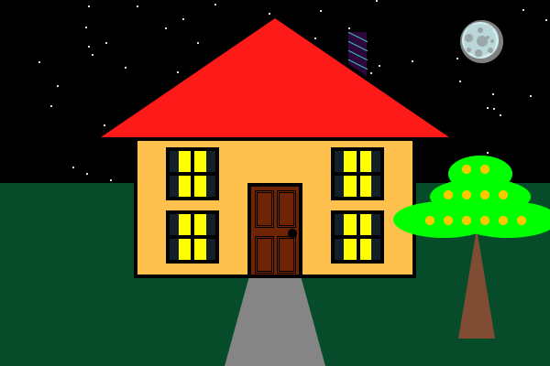
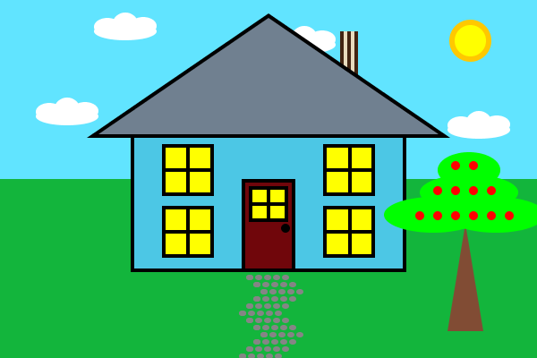
FEATURES AND POSSIBLE OUTCOMES
Things you can customize:
House and roof color
Windows
Chimney
Door
Walkway
Tree
Night or day

Slide 5
Things that we struggled with
- Getting everyone's different parts to work together
- Making sure the program runs without errors
- Cases
- Removing the redundancies
- Getting a time that worked best for everyone to meet and work on the project

